Slide 1

`
A Study on Detection of Retinal Blood Vessels with their Geometrical Physical Characteristics for Retinopathy of Prematurity (ROP)
Presenter: Ashish Kumar
Advisor: Prof. Yo-Ping Huang

Slide 2
Contents
Contribution
Introduction
Methodology
Results
Conclusion
Future Work

Slide 3
Contribution
This study focuses on major problems in ROP diagnosis that is the segmentation of retinal blood vessels in ROP fundus images followed by the length, width, and tortuosity measurement of the segmented blood vessels.
Based on the results the ophthalmologist can perform an early diagnosis of ROP along with the approximate measurements of the vessels and reduce the probability of blindness occurs in infants.

Slide 4
Introduction
In the human eye retinal diseases are correlated with the deformity present in the retina. These retinal diseases if not treated on time lead to vision loss and in some cases permanent blindness.
The regular vascular changes which occur at the back of the eye of an infant occur in a foreseeable manner after birth.
In premature infants because of abnormal development of retinal blood vessels infants lose their eyesight.
In clinical terms this disease is known as Retinopathy of Prematurity (ROP).
Most babies for ROP will develop normal vision for their age but some infants will develop a severe form of ROP that can lead to a retinal detachment.
A retinal detachment is when retinal becomes pulled away or separated from eye ball which can lead to permanent blindness.
ROP remains one of leading cause of irreversible blindness worldwide despite the improvements in ophthalmic overhaul.

Slide 5
Classification of Retinopathy of Prematurity (ROP)
The international classification of retinopathy of prematurity (ICROP) is the system that provides direction for classification of ROP.
Ophthalmologist looks inside an infant’s eyes or photographs of retina to evaluate the level of development of retina.
Retinal development is describe by three zones. Zone I is the least developed and Zone III is the most developed.
Retinal vessels that have grown far and remain in Zone I are the least developed.
As the retina develops the retinal blood vessels grow out from Zone I and enters in Zone II and as retina continues to develop the retinal blood vessels grow into Zone III.
If ROP is present ophthalmologist will describe the severity of ROP as stage of ROP. There are five stages of ROP.
Notes:
They evaluate various parameters while looking in infant’s eyes these are disease location or zone of growth i.e. how far the blood vessels have grown, disease severity or stage of disease and appearance of blood vessels whether they are thick or wavy for determination of plus disease.
Once retinal blood vessels have grown into edge of Zone III they are finished growing and the retina is considered fully developed.
If ROP is present ophthalmologist will describe the severity of ROP as stage of ROP. There are five stages of ROP. The premature retina is considered as stage 0 of ROP which is the least severe stage whereas stage 5 is the most severe stage.

Slide 6
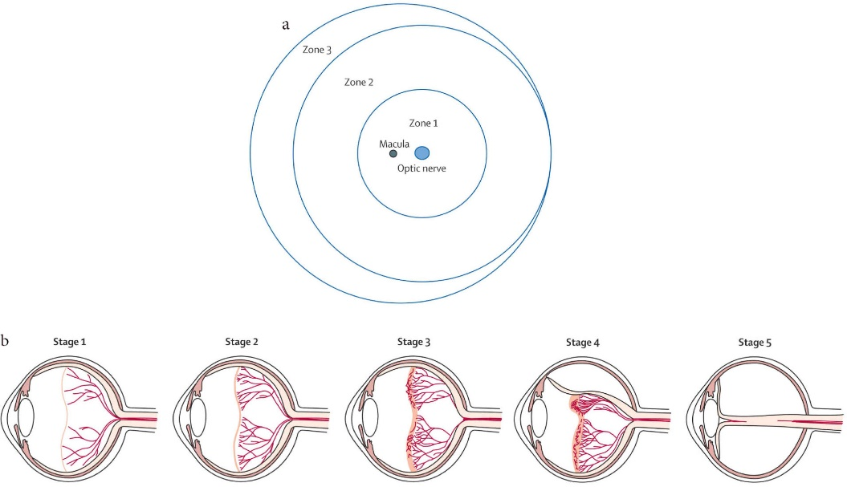
Zones and Stages of Retinopathy of Prematurity (ROP)
Figure 1. Zones and stages of retinopathy of prematurity. (a) Diagram shows the retina in the right eye is divided into three zones. (b) Classification of retinopathy of prematurity: Stage 1, a thin demarcation line between vascularized and nonvascularized retina; Stage 2, a ridge; Stage 3, an extraretinal fibrovascular proliferation; Stage 4, partial retinal detachment; and Stage 5, total retinal detachment.
Image Source: S. Al Rashaed, “Retinopathy of prematurity - a brief review,” Dr. Sulaiman Al Habib Medical Journal, vol. 1, pp.58-64, Dec. 2019.

Slide 7
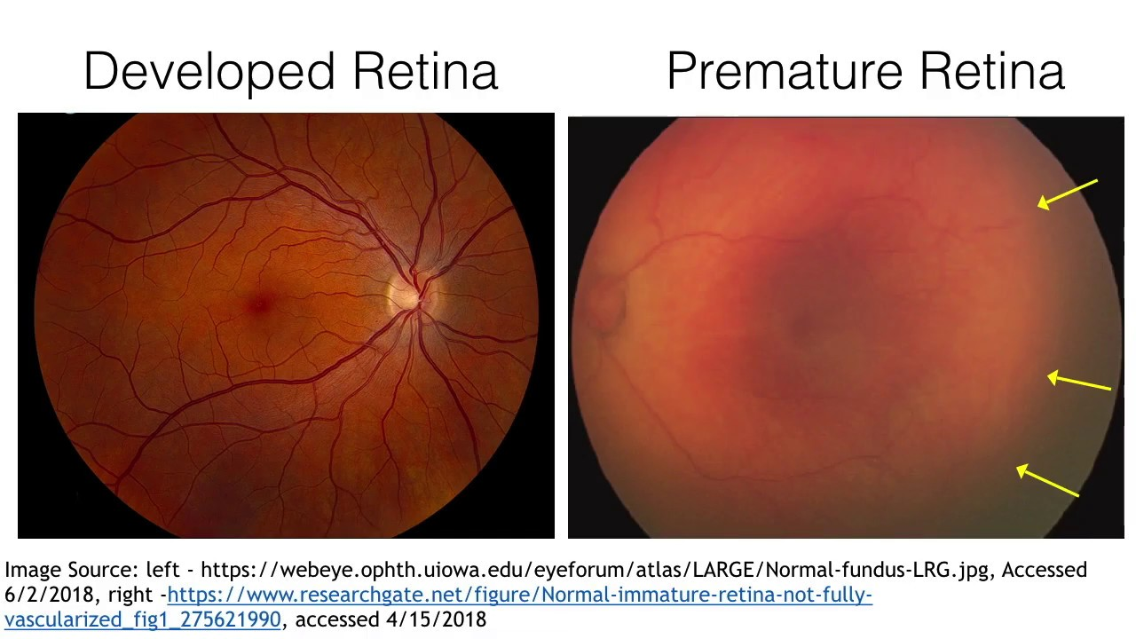
Developed and Premature Retina
In premature retinal images vessel segmentation is a challenging task.
Retinal vessels in premature retinal images do not grow fully and stop growing after a certain time.
In developed retinal images the retinal blood vessels growth could be seen as vessels reach the edges of the image.
In this study premature retinal images were used rather developed retinal images.
(a)
(b)
Figure 2. (a) Developed retinal image. (b) Premature retinal image.
Image Source: (a) https://webeye.ophth.uiowa.edu/eyeforum/atlas/LARGE/Normal-fundus-LRG.jpg
(b) B. W. Fleck and N. McIntosh, “Retinopathy of prematurity: recent developments,” NeoReviews, vol. 10, no. 1, pp.20-30, Jan. 2009.
Notes:
Vessel segmentation in fundus images also depends on different factors such as clarity of images, the amount of noise in images and the clarity of vessels in the images.
Although there are different image filtering and contrast enhancement techniques but not all works sometimes on premature retinal images as the vessels are fragile and not fully grown.
It sometimes becomes difficult for even human eyes to identify the retinal blood vessels in fundus images.
Hand labelling for ground truth of vessels is also difficult and require guidance from an experienced ophthalmologist.

Slide 8
Challenging Issues and Risk Factors
ROP diagnosis from an image can be challenging due to issues such as:
Low contrast between blood vessels and retina.
Variable illumination in image due to wide-field view.
Relatively low image resolution.
Noise present in images.
Appearance of choroidal blood vessels which might be visible on image but do not play part in ROP diagnosis.
Gestational age and birth weight are main risk factors for developing severe ROP.
Other factors associated with presence of ROP include anaemia, supplemental oxygen, poor weight gain, poor overall health, prolonged mechanical ventilation, breathing difficulties and blood transfusions.
Infants who are at risk for ROP are identified by a nurse or doctor in the neonatal intensive care unit (NICU).
If an infant is at risk for ROP an ophthalmologist will perform a series of eye exams at repeated intervals to screen for ROP.

Slide 9
Methodology
Dataset
The dataset used consist of premature retinal images having ROP provided by Chang Gung Memorial Hospital in Taipei, Taiwan.
Nine images are used in this study.
The images are in RGB format with 1600×1200 pixel size per image with 24 bit depth.
It consist of both OS (oculus sinister) means left eye and OD (oculus dextrous) means the right eye images.
It includes images at different stages of ROP.

Slide 10
Flowchart of Proposed Method
Input Image
Green Channel Extraction
Outer Ring and Spur Removal
Grayscale Conversion
Network of Vessels
Contrast Enhancement
Skeletonization
Background Noise Removal
Branchpoints Identification
Background Exclusion
Labelling Vessels
Binarization
Length, Tortuosity and Width of Vessels
Morphological Opening
Smaller Components Removal
Figure 3. Flowchart of proposed method.

Slide 11
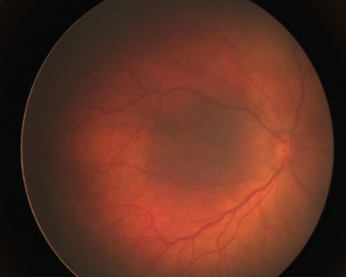
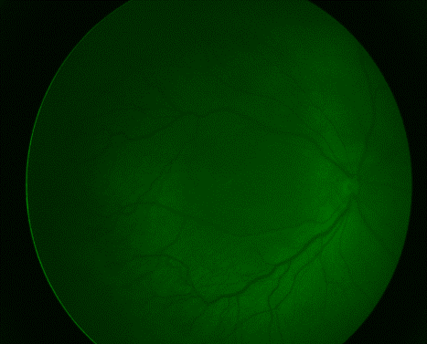
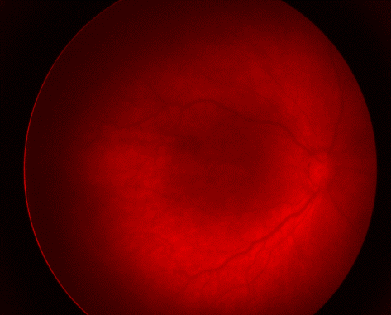
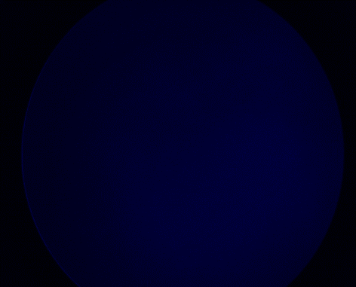
Green Channel Extraction
The input image was separated into channels and one of them was used as input for vessel detection.
The blue channel image was found to be of low contrast and doesn’t have much retinal vessels.
The red channel image was found to be of fair contrast but since most of features were emitting a signal in red channel image and too much noise was present it was not chosen.
The green channel image was selected as it provided an adequate contrast with darker retinal blood vessels on brighter background visible with normal sight.
(a)
(b)
(c)
(d)
Figure 4. Different channel images, (a) original RGB image, (b) red channel image, (c) green channel image, and (d) blue channel image.
Notes:
Not all the channels comprise of clear vessels for image segmentation purpose we investigated the proper channel selection in this study for localization purpose of the retinal blood vessels.

Slide 12
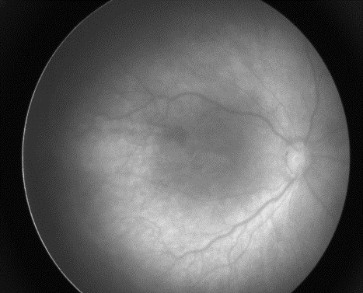
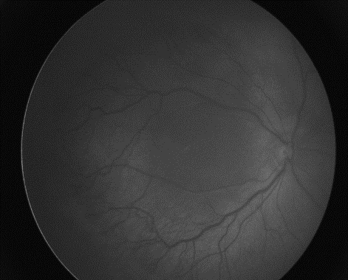
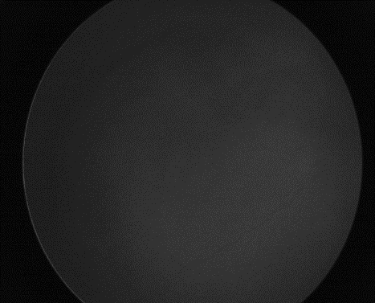
Gray Scale Conversion
The input green channel image was resized to 584×565 to make computation faster as original image was very big.
The original pixel values in image were in integers which cannot accept decimal points. For segmentation of blood vessels precession till decimal points is necessary.
So resized image was converted into double data type after which the conversion was performed in lab color space.
Then the principle component analysis (PCA) of weighted lab color model is used for converting the image into grayscale.
(a)
(b)
(c)
Figure 5. Gray scale images, (a) red channel, (b) green channel, and (c) blue channel.

Slide 13
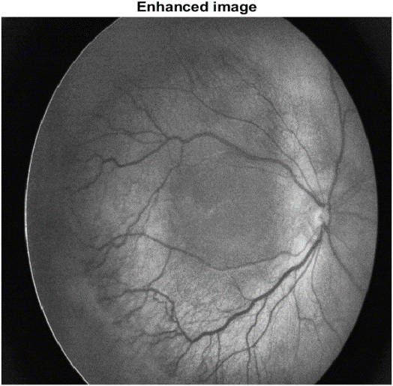
Contrast Enhancement
The contrast enhancement was performed using contrast-limited adaptive histogram equalization (CLAHE).
In contrary to AHE, CLAHE works on smaller regions present in the image which are known as ‘tiles’.
Each tile contrast is enhanced by using this equalization technique resulting in a histogram of output region which approximately match a specified histogram.
The tile size was chosen to be 8×8 and total number of bins selected were 128 for experimental purpose.
Figure 6. Contrast enhanced image.
Notes:
In standard adaptive histogram equalization (AHE) noise present in image also gets amplified so to prevent this we used CLAHE in this study.
In histograms bin is greater than the described contrast limit then those pixels are clipped and distributed to other bins uniformly before AHE. For annihilating artificially induced boundaries CALHE combines the neighbouring tiles using bilinear interpolation.

Slide 14
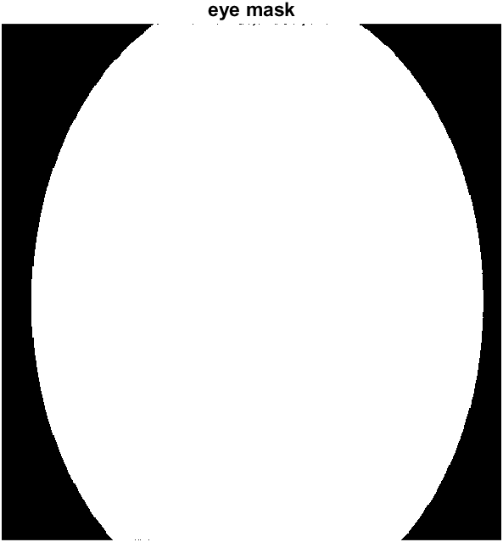
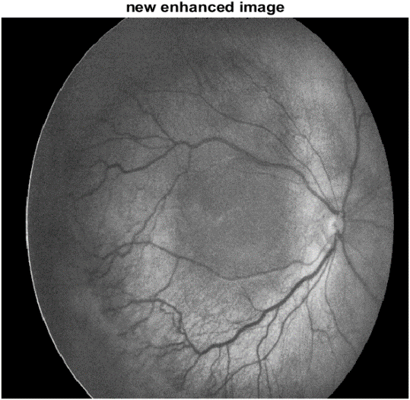
Background Noise Removal
For removing noise we performed background noise removal by creating the mask of input image.
For creating the mask of input mage binarization operation was performed for converting the 2D contrast enhanced image to grayscale.
The holes present in the image were then filled followed by removing smaller objects less than 100 pixels in the converted binary image.
The subtraction of this masked image was performed on the contrast enhanced image to generate a new contrast enhanced image.
(a)
(b)
Figure 7. (a) Background mask, (b) new contrast enhanced image without background noise.

Slide 15
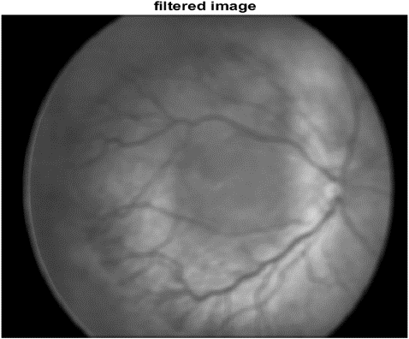
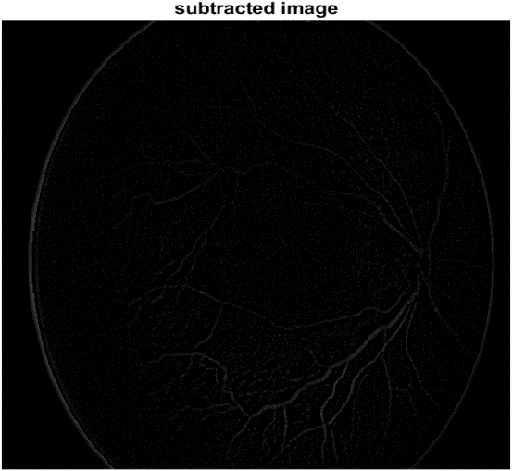
Background Exclusion
For this an image filtering technique was employed. Image filtering is used for highlighting certain features or removing certain features in images.
Spatial domain filter named average filter was used for removing the noise in the inner region of fundus image.
The average filter works by moving through the image pixel by pixel replacing each value with the average of value of neighbouring pixels including itself.
The size of average filter used was 10×10 for experiment purpose.
The background was excluded by subtracting the average filtered image from the new enhanced image.
(a)
(b)
Figure 8. (a) Average filtered image, (b) background excluded image.

Slide 16
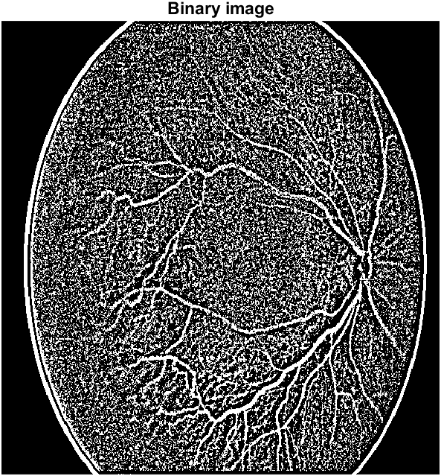
Binarization
To obtain the vessels from the background excluded image a proper threshold value need to be determined.
For determining the threshold value ISODATA method was used.
Then new threshold value was computed as average of these two sample means.
The process repeated until the threshold value does not change any more.
While converting the image to binary image the level was reduced by 0.008 and then binarization was performed.
Figure 9. Binary image.
Notes:
The ISODATA method computes a global image threshold by using iterative isodata method.
This method assists in producing a global threshold i.e. level which was used for converting the intensity image to a binary image.
The derived level value is normalized intensity value and lies between 0 and 1.
Initially the histogram was segmented into two regions where a starting threshold value which is half of maximum dynamic range is selected.
The sample means of the gray values associated with the background and foreground pixels were computed.

Slide 17
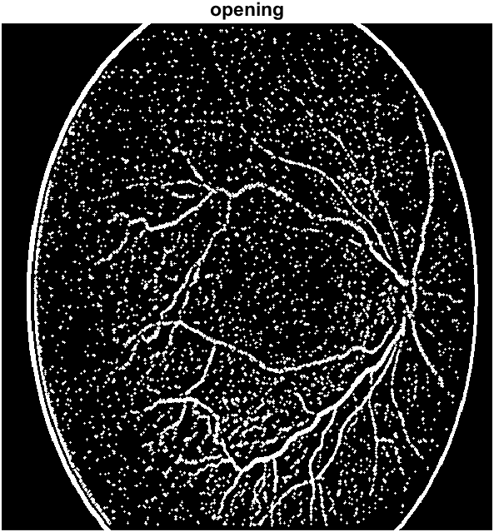
Morphological Opening
For further removing noise at inner region morphological opening operation was performed.
This noise present in the inner region is also white i.e. why the structural differences between the noise present in image and retinal blood vessels are examined.
Morphological opening helps in removing these noises while preserving the vessels which were not in contact with the noises.
Morphological opening is a combination of two morphological operations named erosion and dilation.
A disk-shaped structuring element with a radius of 1 pixel was created and opening operation was performed with help of this structuring element.
Figure 10. Retinal vessel image after morphological opening.
Notes:
After the binarization operation the retinal blood vessels present in the image were classified as black and the background was classified as black.

Slide 18
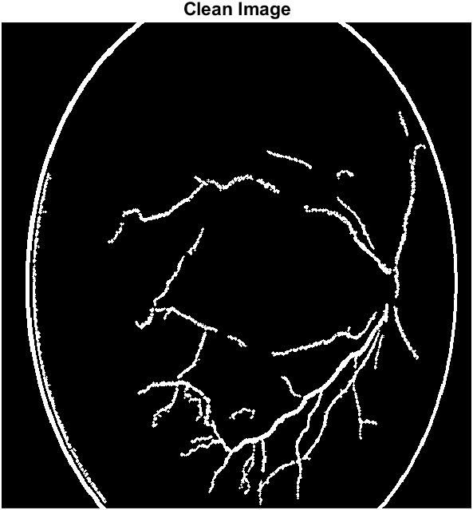
Smaller Components Removal
The retinal vessel image after morphological opening was further cleaned to find out the vessels present in the image which did not come in contact with noise.
For removing the smaller noise still present in image we performed area opening.
After different values were tested the maximum number of pixels in object was specified as a non-negative integer value.
That removed all noises that are fewer than 90 pixels from the vessel image after morphological opening producing image with clean vessels.
Figure 11. Clean image.

Slide 19
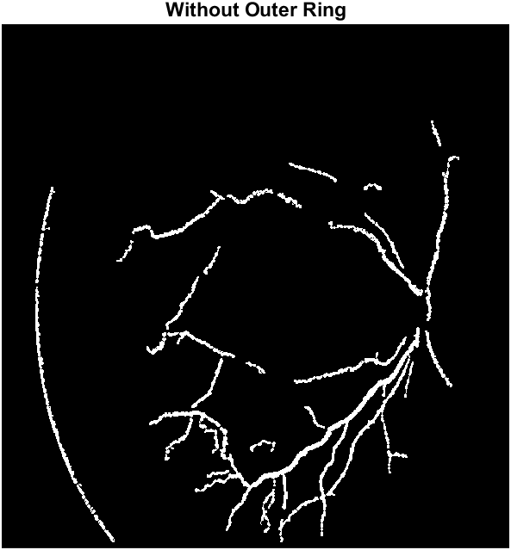
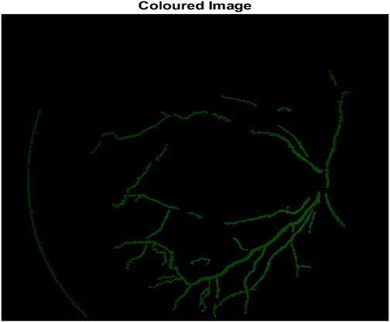
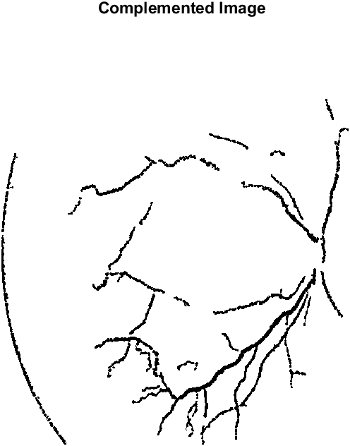
Outer Ring and Spur Removal
For finally extracting the network of vessels outer ring and spur present in the image were removed.
The outer ring formed in fundus images is because of the limits of the fundus cameras. It was removed using the masked image.
After which spur removal was done to remove the unwanted spurs in the image.
(a)
(b)
(c)
Figure 12. (a) Network of vessels, (b) colored image, and (c) complemented image.
Notes:
Spurs are unwanted parasitic components, these appear in retinal vessel segments and are not key to the retinal vessel segments.

Slide 20
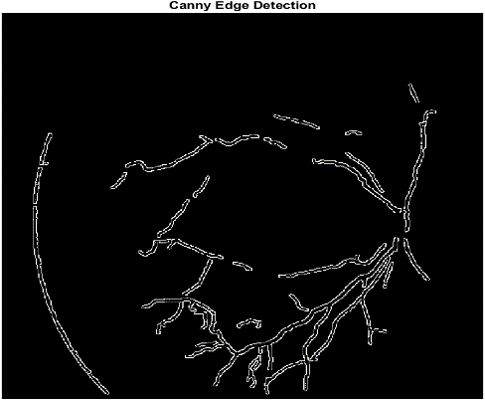
Canny Edge Detection
Edge detection was performed on images to find out the edges of the retinal vessels and to separate different objects like the optic disk if found in images.
Different edge detection techniques were compared named canny, prewitt, roberts, log, zerocross, approx-canny, and sobel.
Canny edge detected result was found to be the cleanest as it was able to find out all edges from the vessel segmented image.
Figure 13. Canny edge detection.
Notes:
After we obtained the network of vessels we performed a certain set of operations to find the length of vessels.

Slide 21
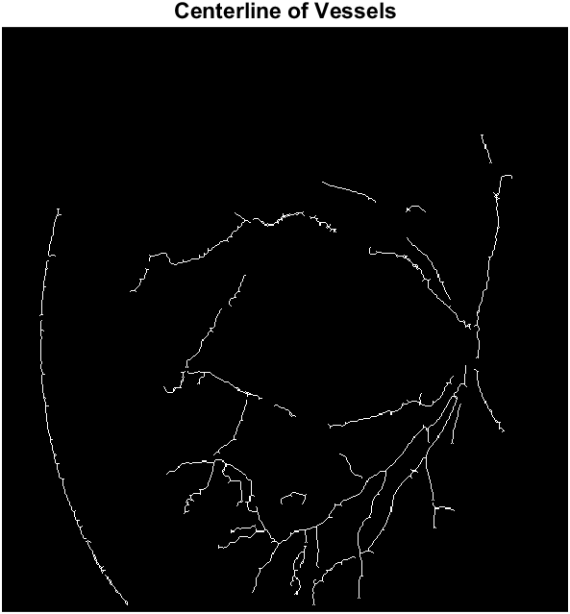
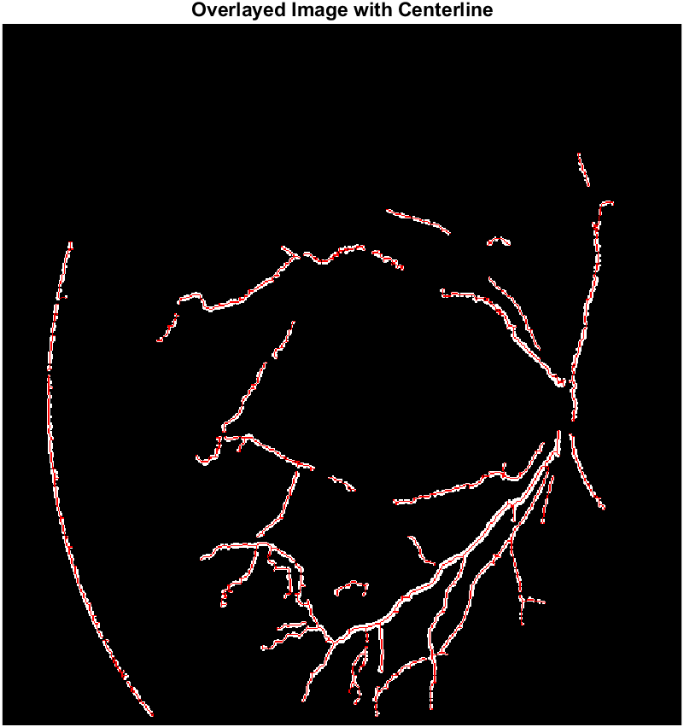
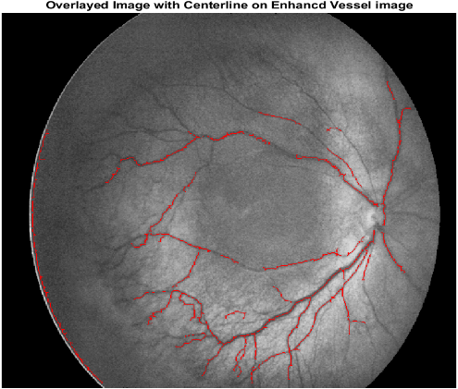
Centreline of Vessels
The centreline of vessels was found out using morphological operation skel.
It removes pixels on the boundaries of objects preventing objects from breaking apart.
The remaining pixels then make up the image showing the centreline of vessels.
The centreline of vessels was overlaid on segmented image and enhanced image for clear visualization of vessel centreline and not identified thin vessels.
(a)
(b)
(c)
Figure 14. (a) Centerline of vessels (b) centerline overlay on segmented image (c) centerline image overlay on enhanced image.

Slide 22
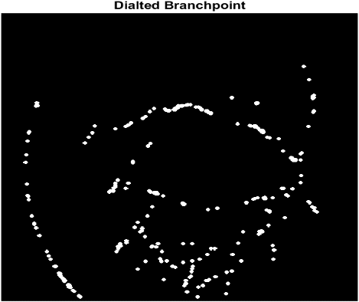
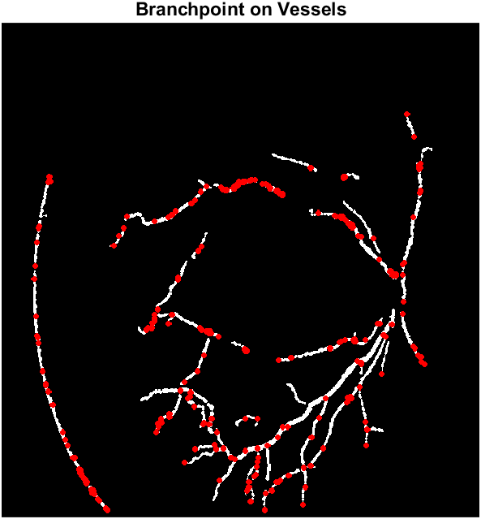
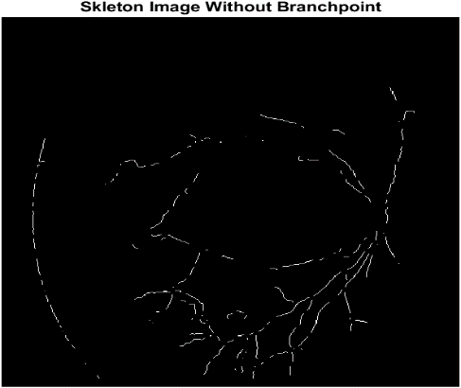
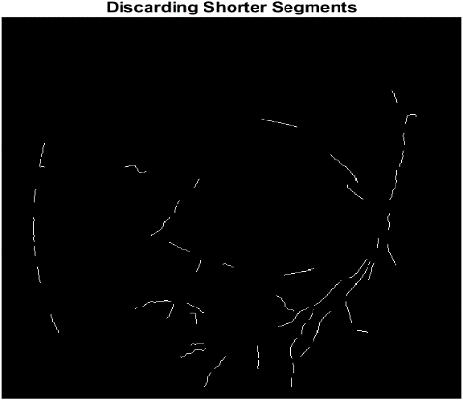
Branching Points Identification
Branching point removal was done in three steps.
Firstly branching points were identified using morphological operations. Some of the missing pixel regions were also included as branching points. The branching points identified were then dilated and overlaid on vessel segmented images to clearly identify the missing pixel and bifurcation points.
Secondly these branching points were removed from the centreline image to obtain an image without branching points.
Thirdly shorter segments below 15 pixels were discarded to obtain only bigger vessels for labelling purposes and calculation of length of vessels.
(a)
(b)
(c)
(d)
Figure 15. (a) Dilated branch points (b) Branch points overlay on segmented image (c) vessel centerline without branch point (d) discarded shorter segments.
Notes:
For the purpose of measuring the length of vessel segments automatically and finding diameter of vessel segments in further steps branching point identification and removal was done.
Therefore, we removed the branching points from the vessels. This was done in three steps. Firstly we identified the branching points using morphological operations.

Slide 23
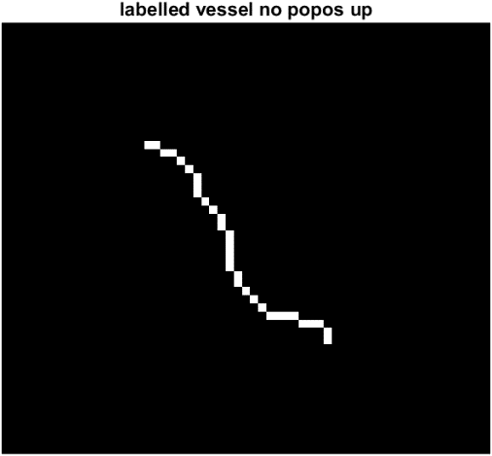
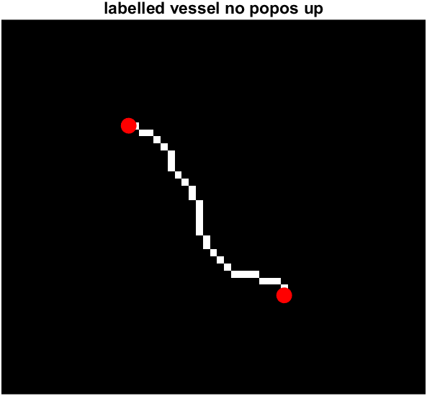
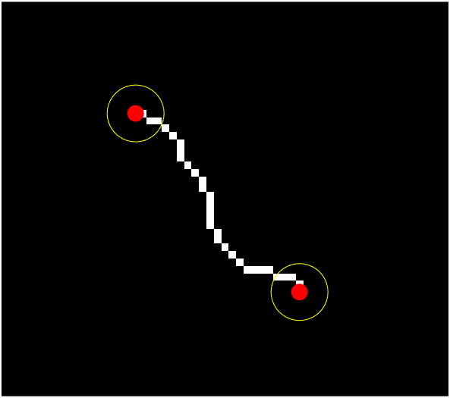
Labelling and Endpoints Detection
Automatically labelling for connected components in image was done. Label returns the label matrix L that contains labels for the 8-connected objects found in image.
Endpoint detection was then performed using two different methods as we used two different approaches for finding out the length of vessel segments.
The endpoint detection was done using morphological operation on binary images and using lookup tables.
A lookup table is generally a column vector in which every element represents the value to return for one possible combination of pixels in a neighborhood.
For example in a 3×3 neighborhood if central pixel is one and if exactly there is one more pixel one in the neighborhood then central pixel is considered as endpoint.
(a)
(b)
(c)
Figure 16. (a) Labelled vessel segment number 25 (b) morphological operation endpoint detection (c) lookup table endpoint detection.
Notes:
Labelling and dilation of vessel segments were performed next. Automatically labelling for connected components in image was done.
The pixels are said to be connected if their edges or corners touch.
Two adjoining pixels are considered part of the same object if they are both on and are connected along the horizontal, vertical, or diagonal direction.

Slide 24
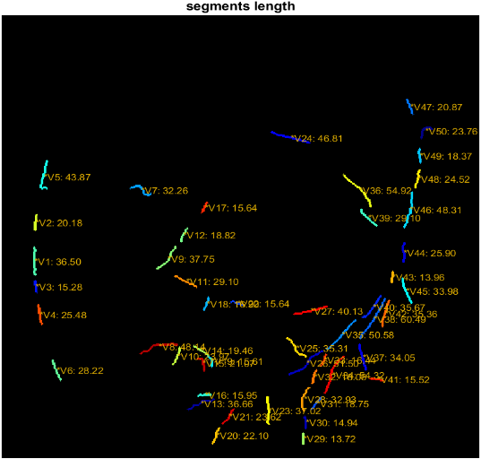
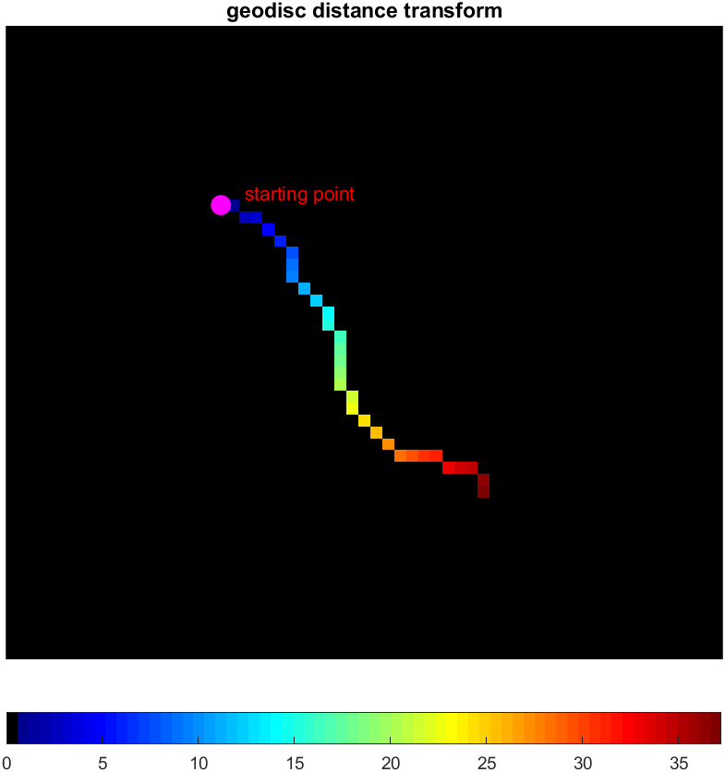
Length of Vessel Segments
For the first method endpoints were found using morphological operations and region properties for measuring properties of image regions where perimeter was used as a property. Perimeter calculates the distance around the boundary of the region which is then returned as a scalar.
Priory the discontiguous regions in image were removed keeping the longer segments only for preventing the model for returning any unexpected results.
For the second method endpoints were found using lookup tables and geodesic distance transform. It calculates the distance between any true pixel in an image and constraint nearest non zero pixel.
(a)
(b)
Figure 17. (a) Length of vessel segments using perimeter (b) Color map of geodesic distance transform.
Notes:
Two methods were used for finding the length.
The perimeter was computed by calculating the distance between each adjoining pair of pixels around the border of the region.

Slide 25
Tortuosity of Vessels Segments
A retinal blood vessels for developed retina are generally straight or to some extent and gradually curved.
Tortuosity was computed for every vessel segment for this element wise division was done between path lengths and distance for vessel segments.
A critical value of 1.2 was added and highlighted the highly tortuous vessels (matter of concern) in images above the critical value.
The value 1.2 is just taken as a random value for the experiment purpose.
The ophthalmologists can decide on a particular value above which they highly tortuous vessels will be highlighted in the image.
Notes:
Retinal vascular diseases can effect tortuosity in its structure defined as a non-smooth appearance of the vessel course or property of a vessel being tortuous.

Slide 26
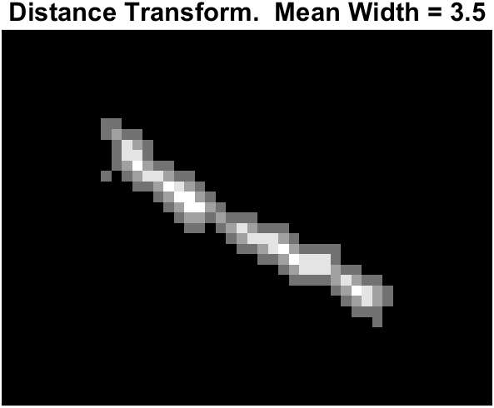
Width of Vessels Segments
For width measurement in ROP images the vessel segmented image and centreline of vessel image were used in which the shorter segments were removed after that they were overlayed.
Labelling was performed on both the set of images and then those labelled were matched.
If all the labelled match then we compute the width.
For every vessel segment Euclidean distance transform was computed.
The distance transform assigns a number that is the distance between that pixel and the nearest non-zero pixel of image.
Figure 18. Width calculation using distance transform for a vessel segment number having mean width 3.5 pixels.
Notes:
The value 1.2 is just taken as a random value for the experiment the ophthalmologists can decide on a particular value above which they highly tortuous vessels will be highlighted in the image.

Slide 27

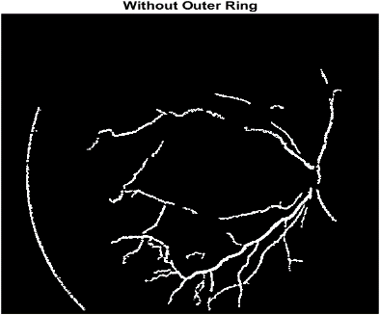
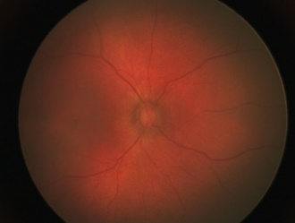
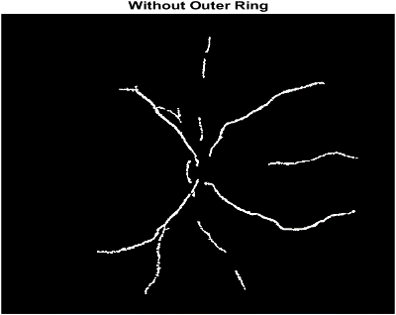
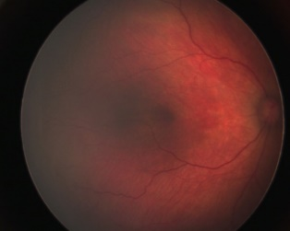
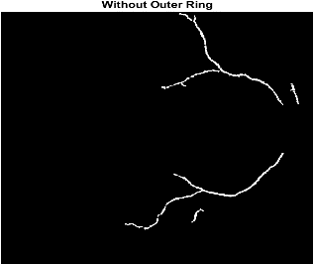
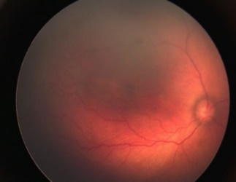
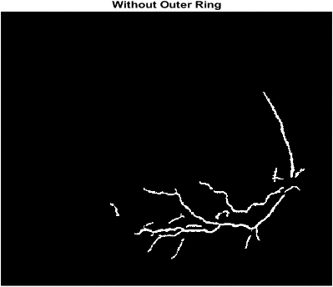
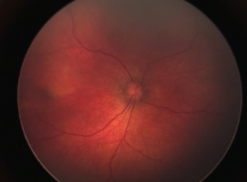
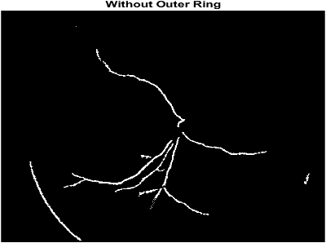
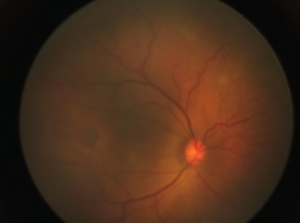
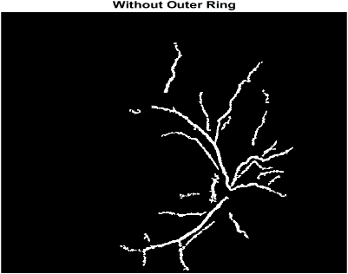
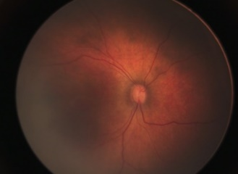
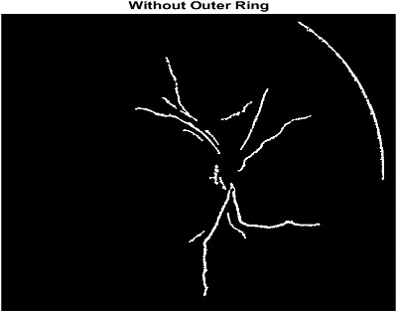
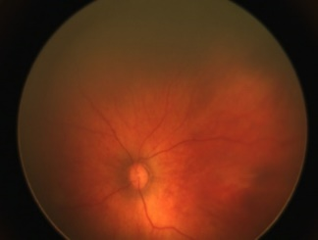
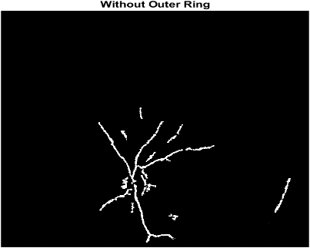
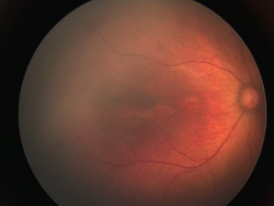

Retinal Vessel Segmentation Results
(a)
(b)
Figure 19. (a) Input images (b) vessel segmented images using proposed algorithm.
(a)
Notes:
Figure 20 shows the retinal vessel segmentation results for seven images used in this experiment. The proposed algorithm segmented most of vessels in the retinal images. Because of noise the missing pixels in vessel segments can be seen in segmented results and very thin vessels at the end were not segmented clearly. Also due to reflection present in image because of camera limited capabilities even after removing the outer ring the reflection was segmented in few images. Therefore, we can learn from other excellent segmentation methods for improving the original image quality before segmentation to improve preprocessing and finally achieve the better vessel segmentation results.
Figure 21 shows retinal vessel segmentation result for image1 and comparison with Coye [15] algorithm. The T.L. coye algorithm which works well on retinal blood vessel segmentation for developed retinal images failed to segment out the vessels in ROP image. One of possible reason for this is due to the fact of noise and illumination issues present in the image another possible reason is [15] algorithm was trained and tested on DRIVE dataset which had only developed retinal images with better contrast and quality which our dataset lacked. For most of the ROP images in our dataset coye algorithm failed to segment out the retinal vessels while ours segmented out vessels with missing pixel issue. Therefore, we can learn from other segmentation methods for initial preprocessing of images to make it somewhat near closer to developed retinal images quality before segmentation to achieve the better results.

Slide 28



Comparison of Retinal Vessel Segmentation Results
The T.L. coye algorithm which works well on retinal blood vessel segmentation for developed retinal images failed to segment out the vessels in ROP image.
One of possible reason for this is due to the fact of noise and illumination issues present in the image another possible reason is algorithm was tested on DRIVE dataset which had only developed retinal images with better contrast and quality.
(a)
(b)
(c)
Figure 20. (a) Input image (b) T. L. Coye segmented image (c) Proposed method segmented image.
Notes:
Figure 21 shows retinal vessel segmentation result for image1 and comparison with Coye [15] algorithm. The T.L. coye algorithm which works well on retinal blood vessel segmentation for developed retinal images failed to segment out the vessels in ROP image. One of possible reason for this is due to the fact of noise and illumination issues present in the image another possible reason is [15] algorithm was trained and tested on DRIVE dataset which had only developed retinal images with better contrast and quality which our dataset lacked. For most of the ROP images in our dataset coye algorithm failed to segment out the retinal vessels while ours segmented out vessels with missing pixel issue. Therefore, we can learn from other segmentation methods for initial preprocessing of images to make it somewhat near closer to developed retinal images quality before segmentation to achieve the better results.

Slide 29

Branching Point Results
Although it was found that there are certain set of missing pixel regions which were misclassified as endpoints all the branching points were detected successfully.
The overlay visualizations helps in identification of branching points and missing pixel positions which are also misclassified as branching points.
(a)
(b)
Figure 21. (a) Input image (b) branching points identified image.

Slide 30




Vessel Measurement Results – Image 1 Stage 3
(a)
(b)
(c)
(d)
(e)
Figure 22. (a) Input image1 (b) clean vessel image (c) vessel segmented image with vessel labelled (d) length of vessel segments using geodesic distance transform. (e) Tortuosity of vessel segments.

Slide 31
Length and Width Measurement Results – Image 1 Stage 3
Table 1. Represents the length and width of vessel one for image1.
Vessel No. | Segment | Length (Pixels) | Width (Pixels)
1 | V44 | 20.25 | 3.50
 | V46 | 16.90 | 3.50
 | V47 | 18.03 | 2.80
 | V48 | 23.54 | 3.31
 | V49 | 46.87 | 3.30
 | V50 | 25.02 | 3.10
Total length and average width |  | 150.61 | 3.20
Table 2. Represents the length and width of vessel two for image1.
Vessel No. | Segment | Length (Pixels) | Width (Pixels)
2 | V45 | 33.53 | 3.20
Table 3. Represents the length and width of vessel three for image1.
Vessel No. | Segment | Length (Pixels) | Width (Pixels)
3 | V20 | 21.54 | 2.60
 | V21 | 23.02 | 2.60
 | V26 | 49.20 | 2.80
 | V35 | 50.33 | 3.50
 | V40 | 35.00 | 3.70
Total length and average width |  | 179.09 | 3.04

Slide 32
































Vessel Measurement Results – Image 2 Stage 2
(a)
(b)
(c)
(d)
(e)
Figure 23. (a) Input image2 (b) clean vessel image (c) vessel segmented image with vessel labelled (d) length of vessel segments using geodesic distance transform. (e) Tortuosity of vessel segments.

Slide 33
Length and Width Measurement Results – Image 2 Stage 2
Table 4. Represents the length and width of vessel one for image2.
Vessel No. | Segment | Length (Pixels) | Width (Pixels)
1 | V18 | 117.95 | 2.60
 | V19 | 47.10 | 2.60
Total length and average width |  | 165.05 | 2.60
Table 5. Represents the length and width of vessel two for image2.
Vessel No. | Segment | Length (Pixels) | Width (Pixels)
2 | V9 | 26.40 | 2.20
 | V11 | 68.12 | 2.20
 | V14 | 15.62 | 2.00
 | V17 | 40.46 | 2.00
Total length and average width |  | 152.60 | 2.10
Table 6. Represents the length and width of vessel three for image2.
Vessel No. | Segment | Length (Pixels) | Width (Pixels)
3 | V1 | 36.67 | 2.60
 | V6 | 41.18 | 2.60
 | V10 | 21.21 | 2.50
 | V12 | 46.69 | 2.50
 | V15 | 80.80 | 2.42
Total length and average width |  | 226.55 | 2.52

Slide 34

Vessel Measurement Results – Image 3 Stage 0
(a)
(b)
(c)
(d)
(e)
Figure 24. (a) Input image3 (b) clean vessel image (c) vessel segmented image with vessel labelled (d) length of vessel segments using geodesic distance transform. (e) Tortuosity of vessel segments.

Slide 35
Length and Width Measurement Results – Image 3 Stage 0
Table 7. Represents the length and width of vessel one for image3.
Vessel No. | Segment | Length (Pixels) | Width (Pixels)
1 | V11 | 38.33 | 4.90
 | V14 | 93.39 | 4.90
Total length and average width |  | 165.05 | 4.90
Table 8. Represents the length and width of vessel two for image3.
Vessel No. | Segment | Length (Pixels) | Width (Pixels)
2 | V18 | 16.16 | 3.80
 | V21 | 50.22 | 3.80
 | V28 | 14.87 | 2.80
Total length and average width |  | 81.25 | 3.46
Table 9. Represents the length and width of vessel three for image3.
Vessel No. | Segment | Length (Pixels) | Width (Pixels)
3 | V2 | 31.58 | 2.80
Table 10. Represents the length and width of vessel four for image3.
Vessel No. | Segment | Length (Pixels) | Width (Pixels)
4 | V1 | 22.85 | 3.24
 | V7 | 24.84 | 3.24
 | V10 | 46.87 | 3.80
 | V16 | 17.20 | 4.20
Total length and average width |  | 111.76 | 3.62

Slide 36

Vessel Measurement Results – Image 4 Stage 0
(a)
(b)
(c)
(d)
(e)
Figure 25. (a) Input image4 (b) clean vessel image (c) vessel segmented image with vessel labelled (d) length of vessel segments using geodesic distance transform. (e) Tortuosity of vessel segments.

Slide 37
Length and Width Measurement Results – Image 4 Stage 0
Table 11. Represents the length and width of vessel one for image4.
Vessel No. | Segment | Length (Pixels) | Width (Pixels)
1 | V5 | 123.98 | 2.50
 | V10 | 34.23 | 2.50
Total length and average width |  | 158.21 | 2.50
Table 12. Represents the length and width of vessel two for image4.
Vessel No. | Segment | Length (Pixels) | Width (Pixels)
2 | V1 | 38.47 | 2.40
 | V3 | 92.48 | 2.42
Total length and average width |  | 130.95 | 2.41
Table 13. Represents the length and width of vessel three for image4.
Vessel No. | Segment | Length (Pixels) | Width (Pixels)
3 | V4 | 18.68 | 2.30
 | V6 | 14.04 | 2.30
 | V9 | 19.24 | 2.20
 | V11 | 18.97 | 2.00
Total length and average width |  | 70.93 | 2.20
Table 14. Represents the length and width of vessel four for image4.
Vessel No. | Segment | Length (Pixels) | Width (Pixels)
4 | V2 | 22.47 | 2.20
Notes:
Vessel No.
Segment
Length (Pixels)
Width (Pixels)
2
V1
38.47
2.40
V3
92.48
2.42
Total length and average width
130.95
2.41

Slide 38


Vessel Measurement Results – Image 5 Stage 2
(a)
(b)
(c)
(d)
(e)
Figure 26. (a) Input image5 (b) clean vessel image (c) vessel segmented image with vessel labelled (d) length of vessel segments using geodesic distance transform. (e) Tortuosity of vessel segments.

Slide 39
Length and Width Measurement Results – Image 5 Stage 2
Table 15. Represents the length and width of vessel one for
image5.
Table 17. Represents the length and width of vessel three for
image5.
Vessel No. | Segment | Length (Pixels) | Width (Pixels)
1 | V3 | 18.44 | 3.40
 | V4 | 49.82 | 3.60
 | V7 | 65.55 | 3.60
Total length and average width |  | 81.25 | 3.50
Vessel No. | Segment | Length (Pixels) | Width (Pixels)
3 | V17 | 24.08 | 3.50
 | V20 | 55.10 | 3.50
 | V23 | 45.18 | 3.40
 | V25 | 17.80 | 3.40
Total length and average width |  | 142.07 | 3.45
Table 16. Represents the length and width of vessel two for
image5.
Table 18. Represents the length and width of vessel four for
image5.
Vessel No. | Segment | Length (Pixels) | Width (Pixels)
2 | V14 | 29.97 | 3.40
 | V16 | 33.02 | 3.42
 | V19 | 20.81 | 3.60
 | V22 | 41.63 | 3.60
Total length and average width |  | 125.43 | 3.50
Vessel No. | Segment | Length (Pixels) | Width (Pixels)
4 | V1 | 32.70 | 3.24
 | V2 | 39.05 | 3.40
 | V6 | 38.08 | 3.50
 | V9 | 18.03 | 3.50
Total length and average width |  | 127.23 | 3.41
Table 18. Represents the length and width of vessel four for image5.

Slide 40

Vessel Measurement Results – Image 6 Stage 2
(a)
(b)
(c)
(d)
(e)
Figure 27. (a) Input image6 (b) clean vessel image (c) vessel segmented image with vessel labelled (d) length of vessel segments using geodesic distance transform. (e) Tortuosity of vessel segments.

Slide 41
Length and Width Measurement Results – Image 6 Stage 2
Table 19. Represents the length and width of vessel one for image6.
Vessel No. | Segment | Length (Pixels) | Width (Pixels)
1 | V7 | 22.83 | 3.50
 | V9 | 111.52 | 3.50
 | V16 | 14.87 | 3.80
Total length and average width |  | 149.20 | 3.60
Table 20. Represents the length and width of vessel two for image6.
Vessel No. | Segment | Length (Pixels) | Width (Pixels)
2 | V17 | 128.08 | 3.50
Table 21. Represents the length and width of vessel three for image6.
Vessel No. | Segment | Length (Pixels) | Width (Pixels)
3 | V12 | 22.36 | 3.10
 | V14 | 117.90 | 3.50
Total length and average width |  | 268.34 | 3.30
Table 22. Represents the length and width of vessel four for image6.
Vessel No. | Segment | Length (Pixels) | Width (Pixels)
4 | V5 | 23.32 | 3.50
 | V6 | 106.25 | 3.60
 | V11 | 61.03 | 3.80
Total length and average width |  | 190.60 | 3.63

Slide 42

Vessel Measurement Results – Image 7 Stage 3
(a)
(b)
(c)
(d)
(e)
Figure 28. (a) Input image7 (b) clean vessel image (c) vessel segmented image with vessel labelled (d) length of vessel segments using geodesic distance transform. (e) Tortuosity of vessel segments.

Slide 43
Length and Width Measurement Results – Image 7 Stage 3
Table 23. Represents the length and width of vessel one for image7.
Vessel No. | Segment | Length (Pixels) | Width (Pixels)
1 | V1 | 148.45 | 3.42
Table 24. Represents the length and width of vessel two for image7.
Vessel No. | Segment | Length (Pixels) | Width (Pixels)
2 | V10 | 121.12 | 3.10
Table 25. Represents the length and width of vessel three for image7.
Vessel No. | Segment | Length (Pixels) | Width(Pixels)
3 | V8 | 135.68 | 3.50
Table 26. Represents the length and width of vessel four for image7.
Vessel No. | Segment | Length (Pixels) | Width (Pixels)
4 | V4 | 209.30 | 3.60

Slide 44





Vessel Measurement Results – Image 8 Stage 2
(a)
(b)
(c)
(d)
(e)
Figure 29. (a) Input image8 (b) clean vessel image (c) vessel segmented image with vessel labelled (d) length of vessel segments using geodesic distance transform. (e) Tortuosity of vessel segments.

Slide 45
Length and Width Measurement Results – Image 8 Stage 2
Table 27. Represents the length and width of vessel one for
image8.
Table 28. Represents the length and width of vessel two for
image8.
Vessel No. | Segment | Length (Pixels) | Width (Pixels)
1 | V15 | 23.32 | 3.80
 | V7 | 106.25 | 3.60
 | V5 | 26.02 | 3.62
 | V3 | 136.19 | 3.42
 | V2 | 70.72 | 3.20
Total length and average width |  | 362.50 | 3.52
Vessel No. | Segment | Length (Pixels) | Width (Pixels)
2 | V17 | 45.69 | 3.82
 | V16 | 30.08 | 3.80
 | V13 | 25.50 | 3.60
 | V6 | 128.29 | 3.60
 | V4 | 16.03 | 3.42
 | V1 | 29.15 | 3.20
Total length and average width |  | 274.74 | 3.57
Table 29. Represents the length and width of vessel three for
image8.
Table 30. Represents the length and width of vessel four for
image8.
Vessel No. | Segment | Length (Pixels) | Width (Pixels)
3 | V18 | 84.65 | 2.80
Vessel No. | Segment | Length (Pixels) | Width (Pixels)
4 | V19 | 34.06 | 2.80

Slide 46





Vessel Measurement Results – Image 9 Stage 2
(a)
(b)
(c)
(d)
(e)
Figure 29. (a) Input image8 (b) clean vessel image (c) vessel segmented image with vessel labelled (d) length of vessel segments using geodesic distance transform. (e) Tortuosity of vessel segments.

Slide 47
Length and Width Measurement Results – Image 9 Stage 2
Table 31. Represents the length and width of vessel one for image9.
Vessel No. | Segment | Length (Pixels) | Width (Pixels)
1 | V15 | 116.40 | 4.80
 | V12 | 69.46 | 4.82
 | V11 | 51.55 | 4.80
Total length and average width |  | 237.41 | 4.80
Table 32. Represents the length and width of vessel two for image9.
Vessel No. | Segment | Length (Pixels) | Width (Pixels)
2 | V17 | 51.61 | 4.82
 | V16 | 35.81 | 4.80
 | V13 | 80.16 | 4.60
 | V10 | 17.49 | 3.80
 | V5 | 14.56 | 3.41
 | V2 | 41.87 | 3.20
 | V1 | 33.02 | 3.20
Total length and average width |  | 274.52 | 3.97

Slide 48
Conclusions
The data used in this study showed that the existing method for segmentation failed while our method was able to segment out retinal vessels on ROP images.
According to the experimental results our retinal vessel segmentation results showed an effective and easy way to reduce the noise present in retinal images.
For length detection two method were tried and tested from which geodesic distance transform algorithm was used for calculating the approximate length of vessels as it gave more precise vessel segments length results then other method.
Our method for width calculation leads to cross checking of automatic labelling of vessel segments and distance transformation used lead to precise calculation for vessels width.
Tortuosity of vessel segments were also calculated separately for every vessel segment and vessels with high tortuosity can be marked easily.
All together it becomes an accommodating tool for ophthalmologist for finding the approximate measurements of the retinal blood vessels and reduce the probability of blindness occurrence in infants by making better decisions on right time.

Slide 49
Future Work
Adding initial preprocessing steps before segmentation of retinal blood vessels for noise and illumination issues present in premature retinal fundus images also to improve the contrast and to clean the fundus image.
The branching points in in retinal blood vessels play an important role in this study the model was incapable in identifying the missing regions and consider them as end points. we will work on preprocessing steps on fundus images to overcome this problem.

Slide 50
Thank You!

